Slide 1
Group 12 – Software Project
Pygame
The River Crossing Problem

Slide 2
Softlearn Amusements LTD requirements
The aim of the project is to create game that uses the “Famer's Problem” logic puzzle to increase to problem solving skills of 12-16 year olds.
The game is a graphical representation of this problem so that it is more interesting for the target audience.
We will add our own original ideas to the software to improve the package as a whole.

Slide 3
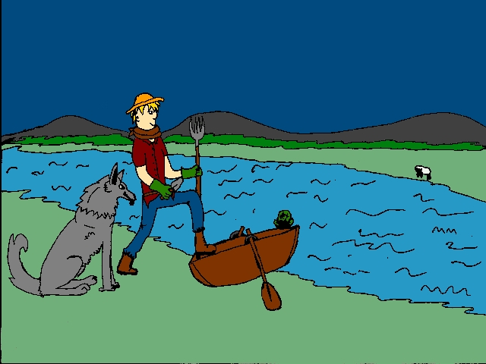

Slide 4
Rules
Boat can only hold farmer and one other item, but the farmer can move on his own.
The wolf and sheep cannot be left alone because the wolf will eat the sheep.
The sheep will eat the cabbage if they are left alone.

Slide 5
Features
The software is going to be used as a learning tool because it is a logic puzzle. It will help promote problem solving skills.
The game features an intuitive menu system that will be easy for 12-16 year olds to use.
It is a great way for teenagers to learn because it is more interactive than standard education methods.
In the next few slides you will see why we have used certain features.

Slide 6
Implemented Features
Additional Features | Advantages
Menu and help system | The game is easy to pick up and play without another document
Bright Colours | Attractive to a younger audience
Animal Sounds | Gives the game more interaction
Easy to read Fonts | Easier for a younger demographic to read.

Slide 7
Possible Features
Additional Features | Advantages
Key Mapping | Allows more universal interaction with the game
Multiple Languages Support | Wider target audience
Multiple Resolutions | Wider product support
Release on Multiple Platforms | Broad system support
Timer and move counter | Adds re-playability
Firework graphics on completion | Adds a reward for learning

Slide 8
Multiple Platforms
As part of the design of this project when it goes ahead and is finished on the PC platform we can proceed to port it to popular mobile platforms like the iOS and Android. This means that any 12-16 year olds that have a smartphone can play the game wherever and whenever they please.
If we implement adverts into this app then we could donate advertisement revenue to charity.

Slide 9
Implementation
The implementation of the program will be a generally easy because all it needs is to be installed onto the system.
The game specifications should be generally low but if the project goes fully ahead we can create full specifications.

Slide 10
Summary
Our features differentiate us from our competition.
Different features that no-one else has
Easy to use
Fun to play
It’s aimed at the young generation
Developing the product into multiple platforms for usability.

Slide 11
Thanks for listening.
Any questions?

